Slide 1
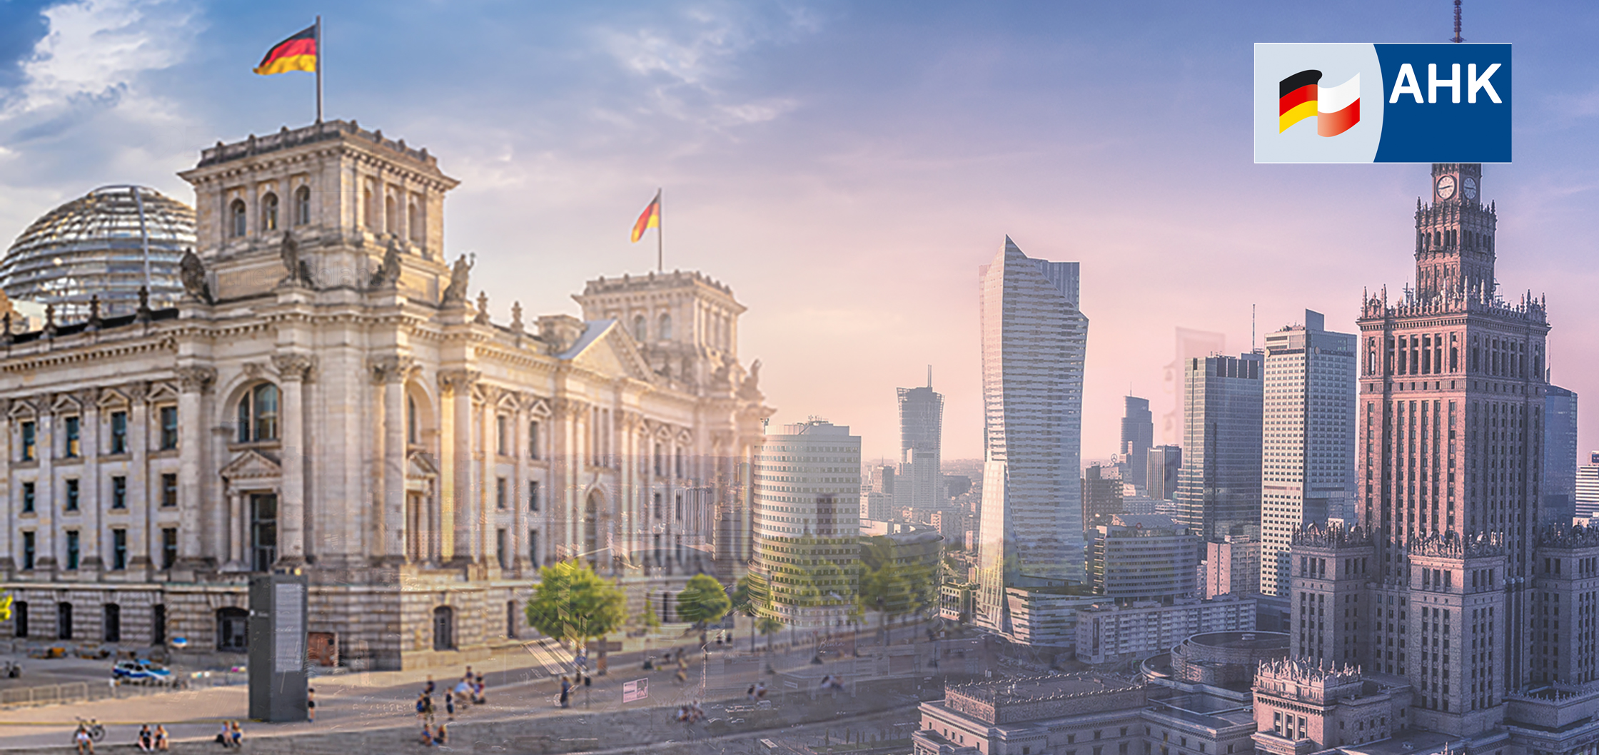



German Energy Transition Policy and potentials for
Polish Business
Lars Gutheil, AHK Polen, Nov. 18th 2024
Notes:
German energy transition policy and the possibilities of cooperation between Germany and Poland in the implementation of European climate policy
CETEF, 18.11.2024

Slide 2
Energy transition in a wider perspective
RENEWABLES ON THE RISE
European integration
Climate Warming
Geopolitical autonomy
Energy prices
Social effects
Business Options
Notes:
Key points of the German energy transition vs. the European Climate Policy
- Fit For 55: the EU has set itself the binding target of achieving climate neutrality by 2050. By 2030, emissions are to be reduced by at least 55 per cent . Globally, it is important to align development, economic, financial, energy and transport policies with climate protection goals
Germany:
With the Renewable Energy Sources Act (EEG) 2023, the German government has consistently aligned the expansion of renewable energies with the goal of the Paris Climate Protection Agreement. This means reducing the global temperature rise to 1.5 degrees Celsius compared to the pre-industrial age.
- According to the EEG, renewable energies should cover at least 80 per cent of German electricity consumption by 2030 - twice as much as in 2021. The higher electricity demand due to the increasing electrification of industrial processes, heat generation and transport is already included in the expansion targets for solar and wind energy.
- The measures are working: In 2023, almost 60 per cent of electricity in Germany came from renewable energies for the first time . This means that with the dynamic expansion of solar and wind power plants, the target of the full 80 per cent is already in sight.

Slide 3
German energy transition vs. European Climate Policy
RENEWABLES ON THE RISE
Reduction of greenhouse gas emissions by 65% in 2030, neutrality in 2045
Nuclear power
terminated in 2023
Coal phase-out: to be completed by 2038
Reduction of greenhouse gas emissions by 55% in 2030, neutrality in 2050
Nuclear Power amounts to 26% of electricity production / no phase out
13% of Coal Share in total electricity production 2023
Notes:
Key points of the German energy transition vs. the European Climate Policy
- Fit For 55: the EU has set itself the binding target of achieving climate neutrality by 2050. By 2030, emissions are to be reduced by at least 55 per cent . Globally, it is important to align development, economic, financial, energy and transport policies with climate protection goals
Germany:
With the Renewable Energy Sources Act (EEG) 2023, the German government has consistently aligned the expansion of renewable energies with the goal of the Paris Climate Protection Agreement. This means reducing the global temperature rise to 1.5 degrees Celsius compared to the pre-industrial age.
- According to the EEG, renewable energies should cover at least 80 per cent of German electricity consumption by 2030 - twice as much as in 2021. The higher electricity demand due to the increasing electrification of industrial processes, heat generation and transport is already included in the expansion targets for solar and wind energy.
- The measures are working: In 2023, almost 60 per cent of electricity in Germany came from renewable energies for the first time . This means that with the dynamic expansion of solar and wind power plants, the target of the full 80 per cent is already in sight.

Slide 4
German energy transition vs. the European Climate Policy
CETEF’2024 Krakow
Germany:
Renewable Energy Sources Act (EEG) 2023:
2023 - 60% of electricity in Germany came from renewable energies
2030 - 80% of German electricity
consumption by 2030 should be coverd by renewable energies
EU:
Fit For 55:
2023 – 24,1% of electricity in EU came from renewable energies*
2030 - 42% of electricity consumption in EU by 2030 should be coverd by renewable energies*
*Source https://www.eea.europa.eu/en/analysis/indicators/share-of-energy-consumption-from
Notes:
Key points of the German energy transition vs. the European Climate Policy
- Fit For 55: the EU has set itself the binding target of achieving climate neutrality by 2050. By 2030, emissions are to be reduced by at least 55 per cent . Globally, it is important to align development, economic, financial, energy and transport policies with climate protection goals
Germany:
With the Renewable Energy Sources Act (EEG) 2023, the German government has consistently aligned the expansion of renewable energies with the goal of the Paris Climate Protection Agreement. This means reducing the global temperature rise to 1.5 degrees Celsius compared to the pre-industrial age.
- According to the EEG, renewable energies should cover at least 80 per cent of German electricity consumption by 2030 - twice as much as in 2021. The higher electricity demand due to the increasing electrification of industrial processes, heat generation and transport is already included in the expansion targets for solar and wind energy.
- The measures are working: In 2023, almost 60 per cent of electricity in Germany came from renewable energies for the first time . This means that with the dynamic expansion of solar and wind power plants, the target of the full 80 per cent is already in sight.

Slide 5
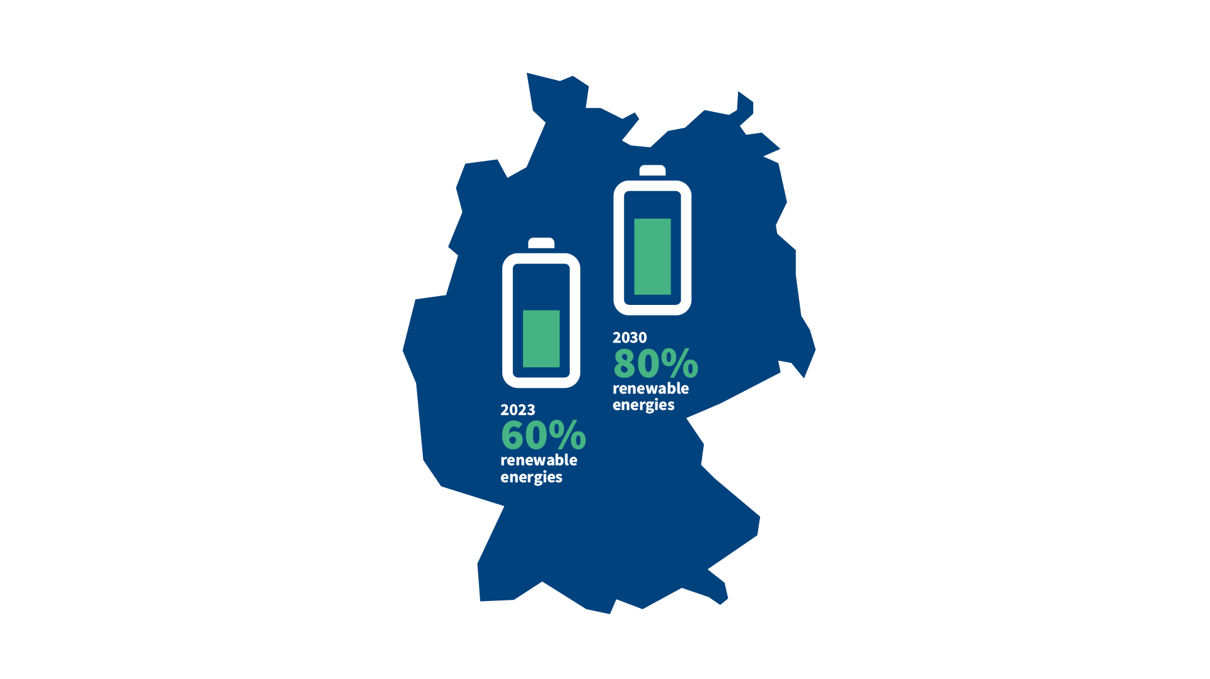
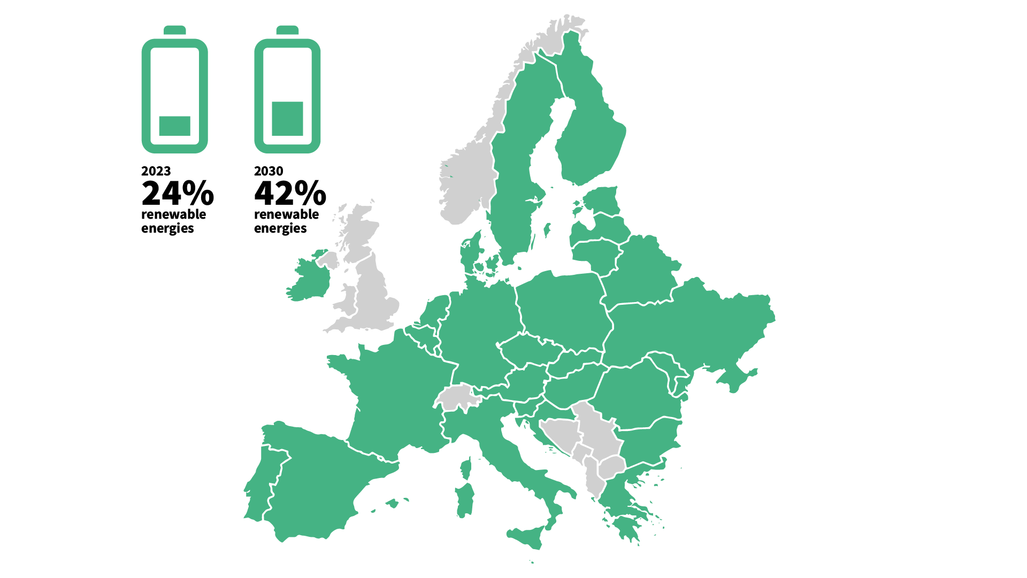
German energy transition vs. European Climate Policy
GERMANY AS EUROPEAN FRONTRUNNER
Notes:
Key points of the German energy transition vs. the European Climate Policy
- Fit For 55: the EU has set itself the binding target of achieving climate neutrality by 2050. By 2030, emissions are to be reduced by at least 55 per cent . Globally, it is important to align development, economic, financial, energy and transport policies with climate protection goals
Germany:
With the Renewable Energy Sources Act (EEG) 2023, the German government has consistently aligned the expansion of renewable energies with the goal of the Paris Climate Protection Agreement. This means reducing the global temperature rise to 1.5 degrees Celsius compared to the pre-industrial age.
- According to the EEG, renewable energies should cover at least 80 per cent of German electricity consumption by 2030 - twice as much as in 2021. The higher electricity demand due to the increasing electrification of industrial processes, heat generation and transport is already included in the expansion targets for solar and wind energy.
- The measures are working: In 2023, almost 60 per cent of electricity in Germany came from renewable energies for the first time . This means that with the dynamic expansion of solar and wind power plants, the target of the full 80 per cent is already in sight.

Slide 6



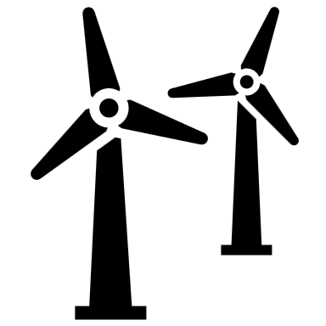
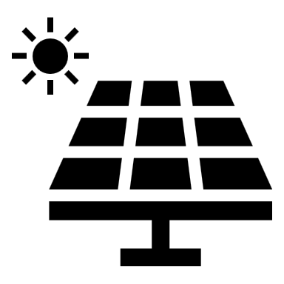
German Energy Mix 2024 <> 2030
TARGETS FOR THIS DECADE
Notes:
German Energy Mix 2024 – (source Frauenhofer ISE 2024)
35% - Wind, 16% -Photovoltaics, 10% -Biomass, 5% - Hydropower, 16% - Lignite, 12%-Natural Gas, 6%-Hard coal
German Energy Mix 2030 – (source DIW Berlin: Startseite)
47% - Wind, 27% - Photovoltaics, 3%- Biomass, 3% - Hydropower, 20% - Fossil

Slide 7
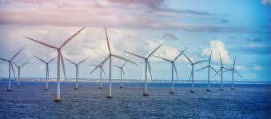
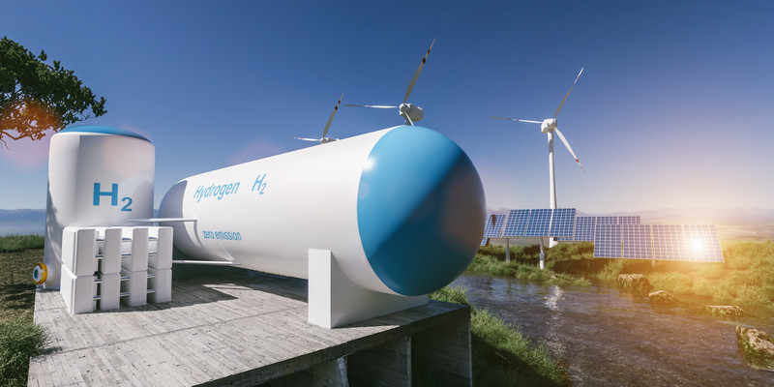
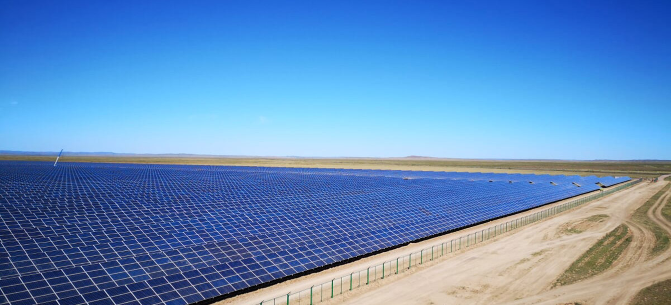
Renewable Energy sources in focus
CETEF 2024
Notes:
Expansion of renewable energies
- In order to achieve the climate targets, the German government has significantly accelerated the expansion of wind and solar power plants. The foundations for this have been laid with various laws and support packages (the Wind on Land Act and the Wind Energy at Sea Act, the first solar package and several amendments to the Energy Industry Act; Pact for Accelerated Planning and Approval - the pace for the expansion of renewable energies is thus being increased).
- In the first half of 2024, for example, significantly more permits were issued for new wind turbines. The number of approvals in the wind energy sector almost doubled in 2023 - and that in just one year. In concrete figures, this means that almost 8,000 megawatts of wind capacity were approved in 2023, compared to just over 4,000 megawatts in 2021 and 2022. With the accelerated pace of expansion, projects are being approved on average four months faster than a year ago.
- The expansion of solar energy is also booming: photovoltaic systems the size of 34 soccer pitches are currently being installed in Germany every day. This means that the expansion target for photovoltaics set out in the Renewable Energy Sources Act for the whole of 2024 - a total of 88 gigawatts - was already reached at the beginning of May.
Hydrogen ramp-up: Green hydrogen is the key to an energy supply without CO2 emissions. The gas, which is produced using solar and wind energy, is set to be a key energy source in the future to make Germany climate-neutral by 2045.
- Import strategy: in order to reduce emissions of CO2 in the near future, considerable quantities of hydrogen will have to be imported for the time being from the end of this decade. The German government is working on establishing a viable hydrogen market (South and West Africa and Australia)
- A hydrogen network with more than 1,800 kilometers of old, converted and new pipelines is to be created by 2027/2028
At the end of 2023, Germany had photovoltaic systems with a total output of over 80 gigawatts. This corresponds to an increase of 20 per cent compared to the previous year. By 2030, the capacity is expected to increase to 215 gigawatts and even to 400 gigawatts by 2040.
Photovoltaic systems are politically less controversial and less bureaucratic than wind farms. This is why expansion is proceeding comparatively quickly.

Slide 8
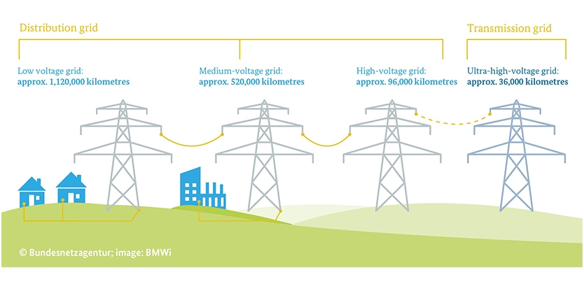
Germany electricity distribution grid
CETEF’2024 Krakow

Slide 9
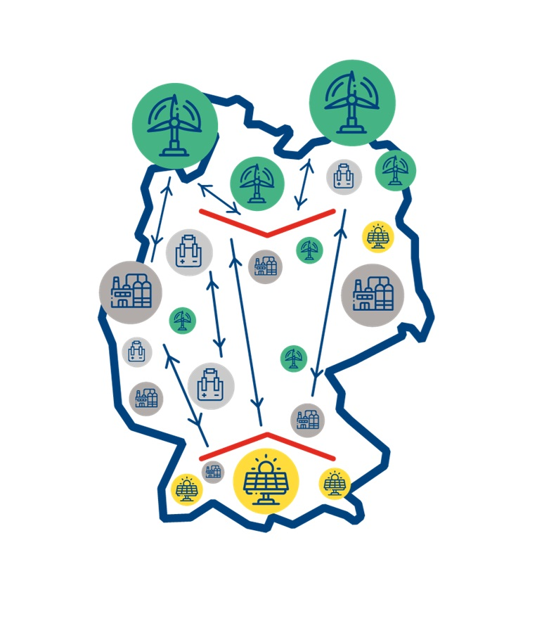
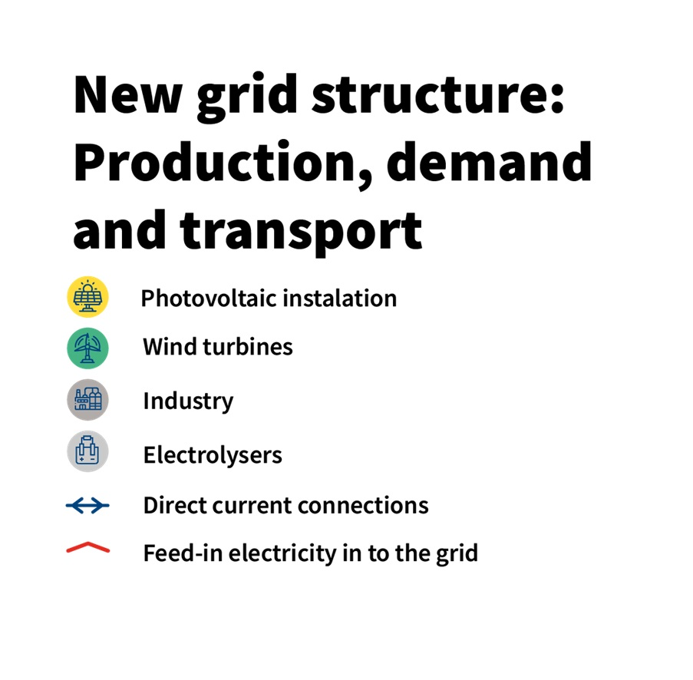
Germany electricity distribution grid
CHALLENGES
Notes:
0 per cent is already in sight.

Slide 10
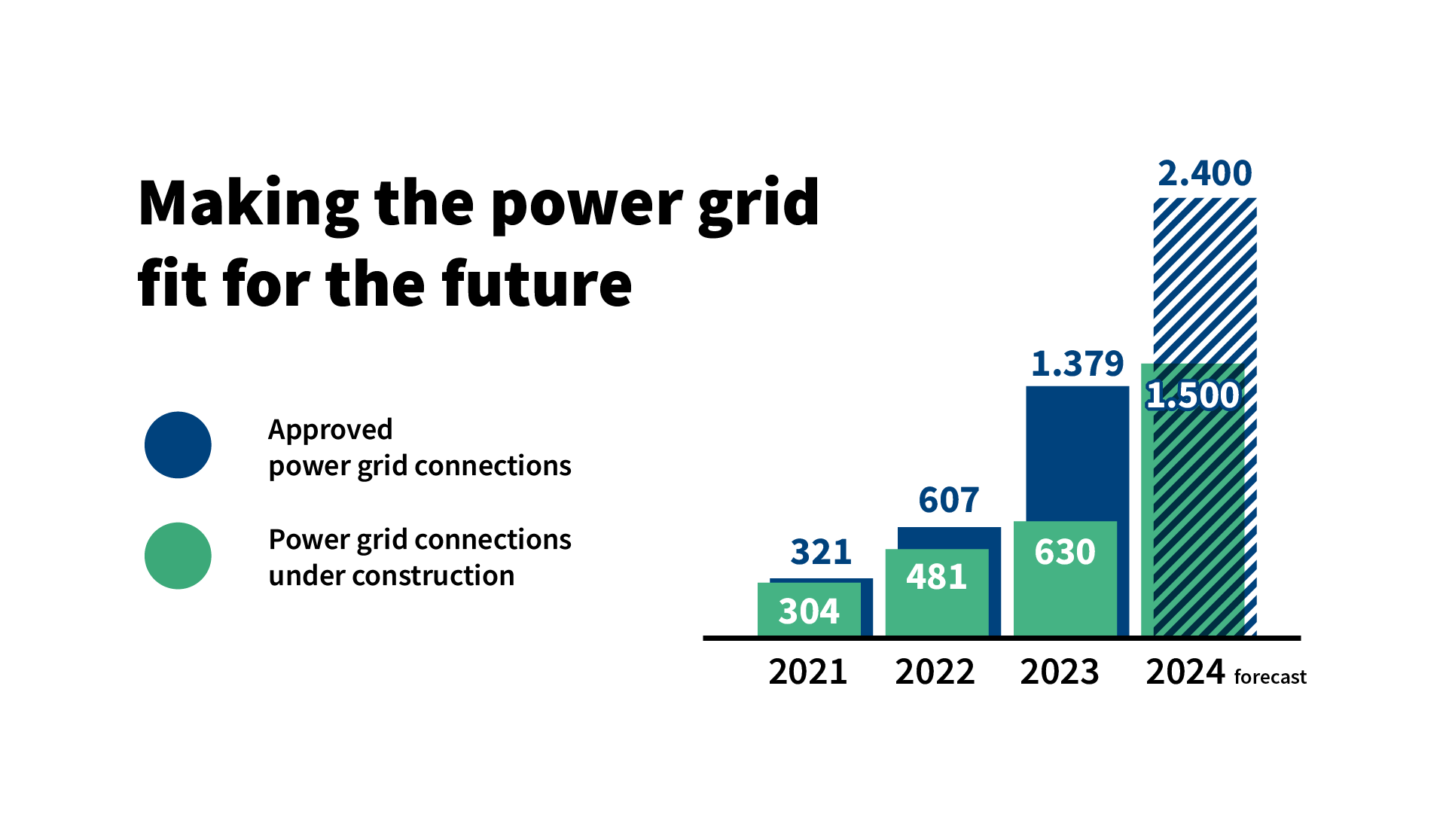
Germany electricity distribution grid
CHALLENGES
Notes:
0 per cent is already in sight.

Slide 11

Challenges of the energy transformation
GERMANY
Security: Supply and Facilities/Infrastructure
(Offshore - Baltic Sea)
Infrastructure: Industry largely in the South, electricity production (e.g. wind turbines) in the North
Costs - massive investments required
Reorientation of the supplier market - search for new collaborations (e.g. H2 – incl. outside Europe)
Social aspects - in view of the high costs of the transformation

Slide 12

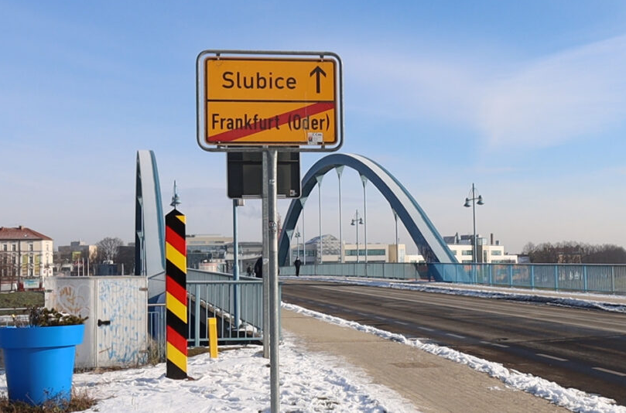
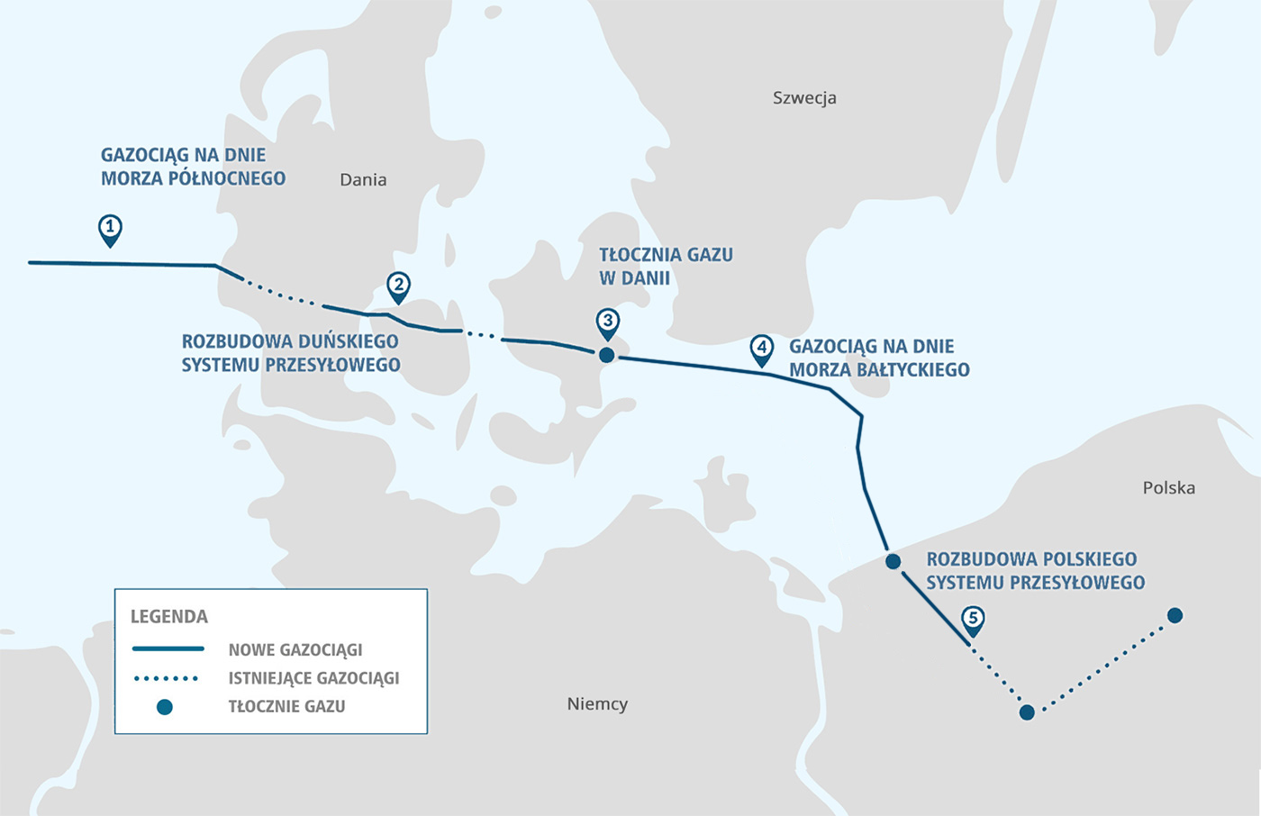

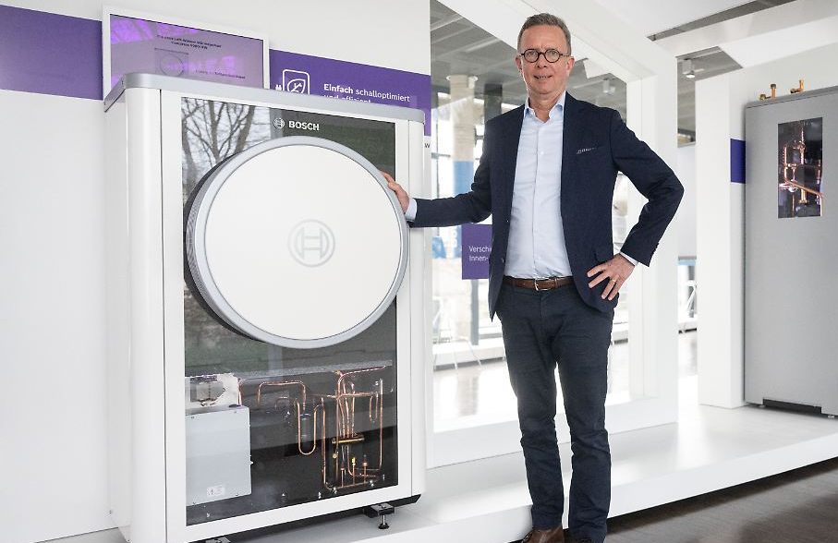
Potentials & Cooperations
ENERGY TRANSITION
Polish-German Projects
Euopean Cooperation
Innovative Invests since 2022
District heating grid in Frankfurt Oder / Słubice // Görlitz / Zgorzelec
Baltic Pipe from Denmark to Poland
Baltic Hydrogen Partnership?
Heat pump plant Bosch
Solar plant Goldbeck Solar
*Plans Source: Potentialanalyse AHK, Deutschlandplattform Bildquellen: Getty Images, Frankfurt/Oder, Baltic Pipe, Bosch

Slide 13
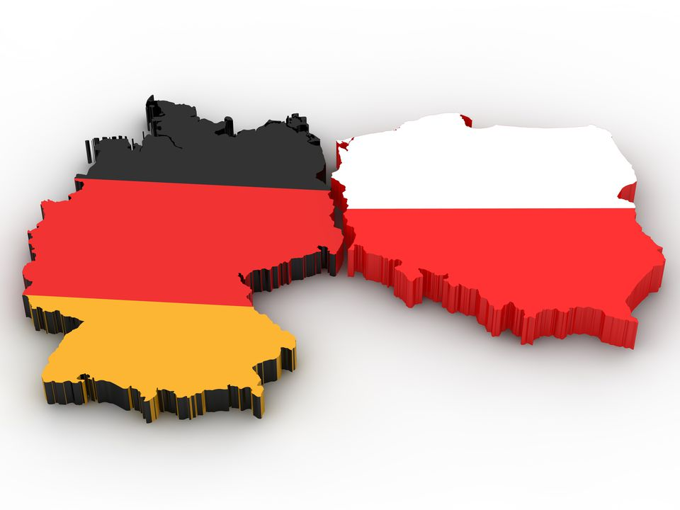
Potential areas of cooperation
GERMANY AND POLAND
Photovoltaics
Energy storage
Recycling and co-operation
Safety and offshore wind power
Hydrogen
Wind power
Electromobility
Power lines and cables

Slide 14
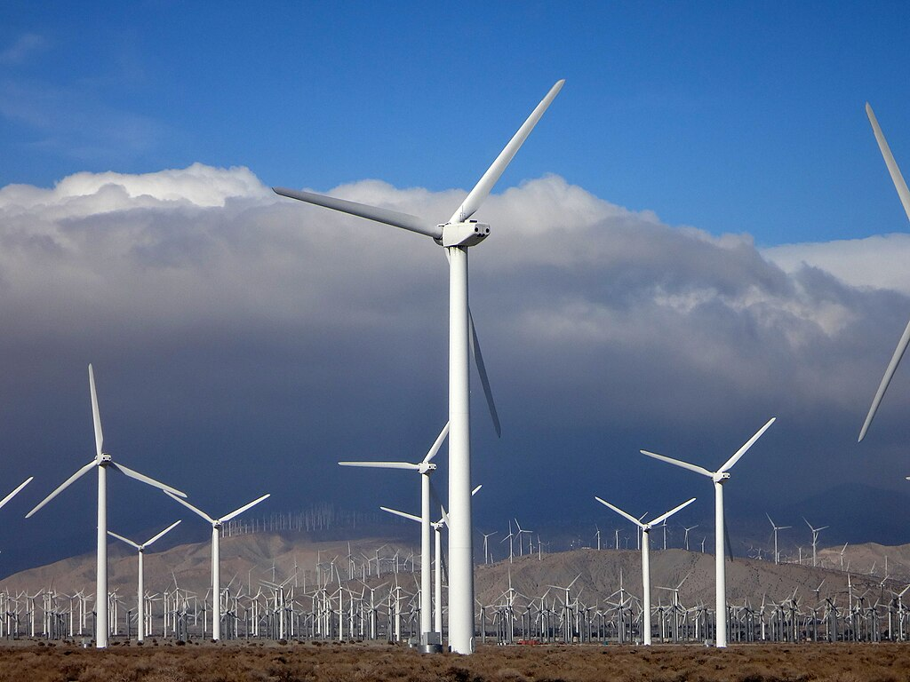
Potentials of Wind power
AREAS OF COOPERATION
Polish companies are reorganising their business model in the light of the energy transformation
Supply of parts for wind turbines, construction and maintenance of wind farms (Famur)
Manufacturing of turbines
Germany: a large wind power market
Notes:
Polish companies are reorganising their business model in the light of the energy transformation.
A good example is the mechanical engineering company Famur.
Famur used to earn its money by building equipment for the mining industry. The company now supplies parts for wind turbines and takes on the construction and maintenance of wind farms. In the future, the company even wants to manufacture its own turbines.
As a large wind power market, Germany would be an obvious market for expansion.

Slide 15
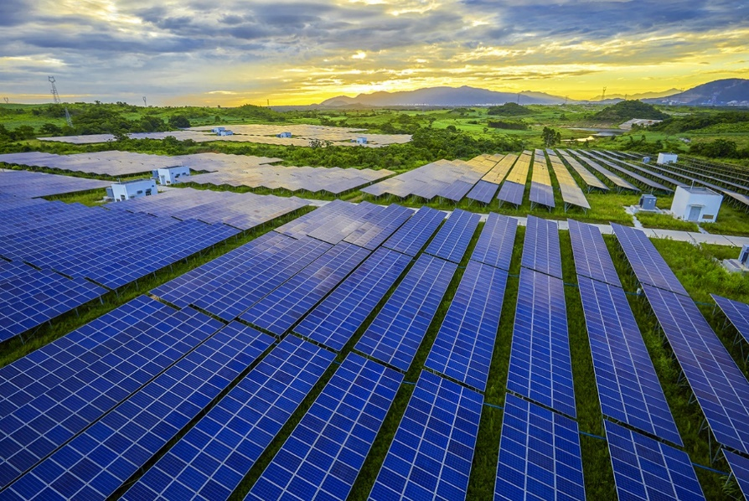
Potential of Photovoltaics
AREAS OF COOPERATION
Supply of photovoltaic modules, metal constructions and other technology
Facade-integrated photovoltaic modules
Development of photovoltaic parks in Germany
Notes:
The Polish company Corab supplies photovoltaic modules, metal constructions and other technology to Germany. The company has its own German branch.
Poland's leading manufacturer of façade-integrated photovoltaic modules (Building Integrated Photovoltaics) has been active in Germany for a long time and has, for example, supplied windows with integrated photovoltaic modules to construction projects in Bavaria.
Companies in Poland are not only suppliers, they are also developing their own photovoltaic parks in Germany. One example is the company R.Power, which has built a number of solar farms, particularly in eastern Germany.

Slide 16
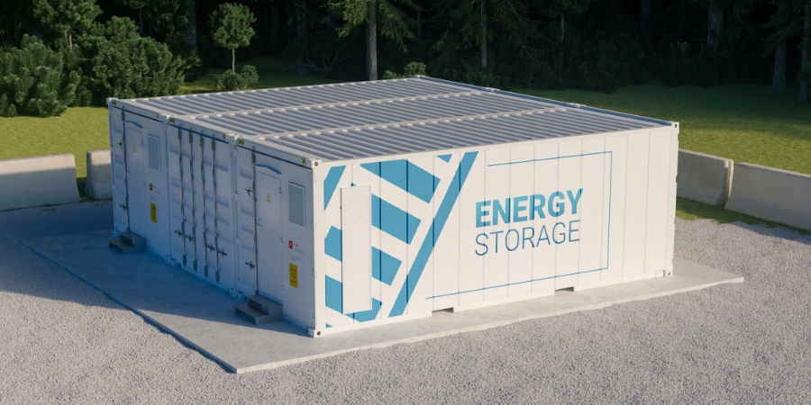
Potentials of Energy storage
AREAS OF COOPERATION
Sales of energy storage systems in Germany are already growing by 25 per cent to 50 per cent annually, depending on whether they are home systems or industrial systems.
Large-scale storage systems will develop particularly dynamically - Polish companies such as the Impact Group can benefit from this.
Notes:
Installations on rooftops and in private households have played an important role in the growth of photovoltaics. For example, the Solar Package I that came into force facilitates the connection of so-called balcony power plants.
As in Poland, consumers save the most money if they consume the electricity generated on site and do not feed it into the grid. This increases the need for energy storage systems.
Sales of energy storage systems in Germany are already growing by 25 per cent to 50 per cent annually, depending on whether they are home systems or industrial systems.
According to analysts, large-scale storage systems will develop particularly dynamically. Polish companies such as the Impact Group can benefit from this.

Slide 17
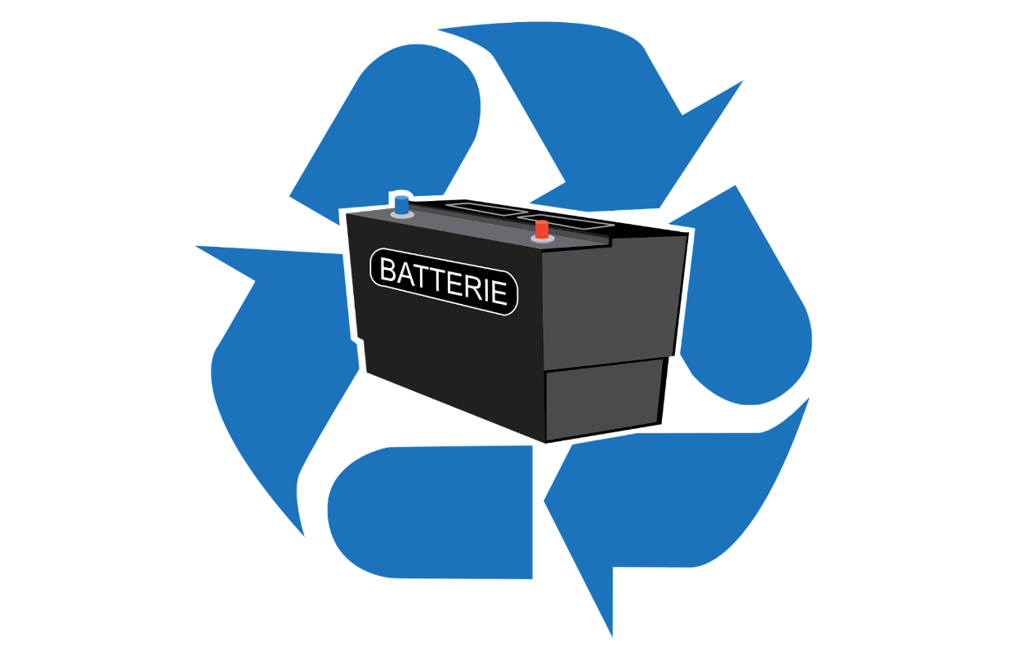
Potentials of Recycling
AREAS OF COOPERATION
Collaborations on new technologies for recycling panels and cells could be established between German and Polish start-ups
Poland is home to one of the largest battery recycling plants in Europe - a joint venture between the Polish company Elemental Strategic Metals and the US company Ascend Elements. Both companies also want to build a recycling plant in Germany together.
Notes:
photovoltaic systems installed today will have to be recycled in the future. Start-ups from Germany are working with the Korean company Hyundai on new technologies for recycling panels and cells. Such collaborations could also be established between German and Polish companies.
Poland is home to one of the largest baThettery recycling plants in Europe. It is located in Zawierce and is a joint venture between the Polish company Elemental Strategic Metals and the US company Ascend Elements. Both companies also want to build a recycling plant in Germany together.

Slide 18
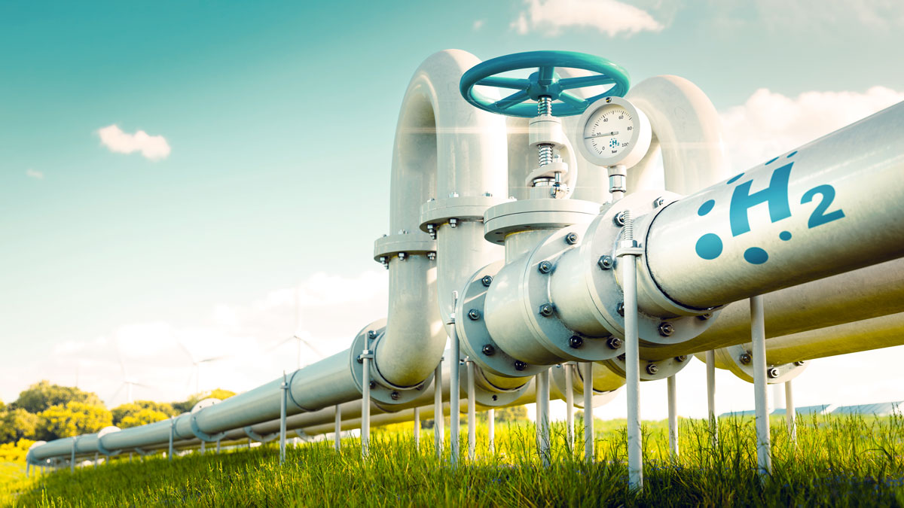
Potentials of Hydrogen
AREAS OF COOPERATION
Germany's most important industrial centres are to be connected to each other by a hydrogen pipeline network (9,000 kilometres)
Poland has a large number of metal and plastic suppliers – potential partner for the construction of hydrogen pipelines.
Supplier of H2: joint pipeline infrastructure and production of H2
Notes:
Some branches of industry, such as the chemical industry, aviation and shipping, are difficult to electrify. This is where hydrogen should play an important role.
Germany's most important industrial centres are to be connected to each other by a so-called core network. The details have been finalised since October 2024 and the core grid has been approved. The network will have a total pipeline length of more than 9,000 kilometres. 56 per cent will be converted gas pipelines, the rest will consist of newly laid pipelines. The costs amount to almost 19 billion euros.
Hydrogen pipes are technically very demanding. Hydrogen is a volatile chemical element, which is why the pipes and the connecting pieces must be very tight. Poland has a large number of metal and plastic suppliers (Metall- und Kunststoffverarbeiter). This experience makes Poland a good partner for the construction of hydrogen pipelines.
The German government estimates that Germany will cover up to 70 per cent of its hydrogen requirements with imports in the future. It is quite possible that some of this hydrogen will come from Poland. Polish and German network operators are already working on a joint pipeline infrastructure. Polish energy giants such as Orlen could also produce hydrogen for customers in Germany.

Slide 19
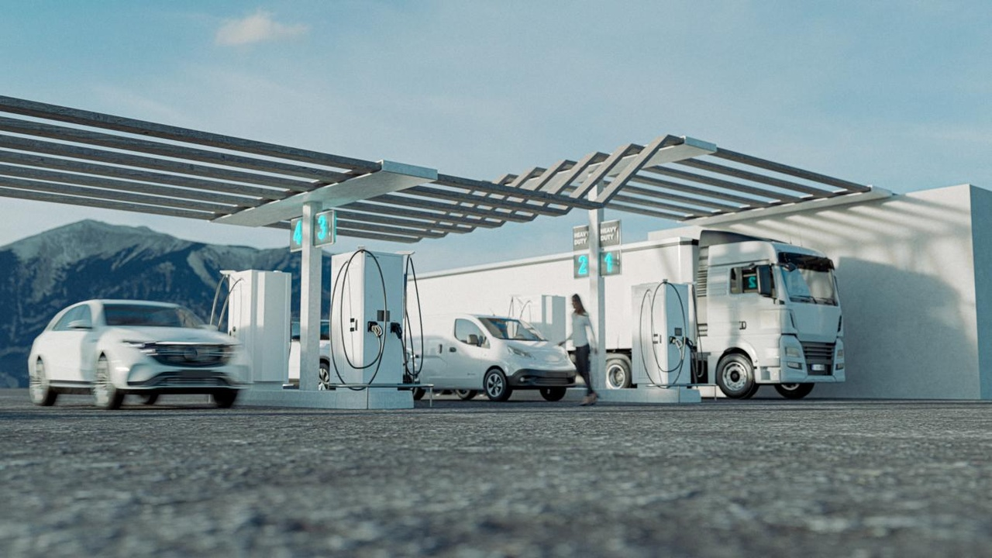
Potentials of Electromobility
AREAS OF COOPERATION
Charging points
Companies such as Eko Energetyka charge electric buses in many German cities, for example in Hamburg
The operator of Halle/Leipzig Airport is currently installing charging points from Eko Energetyka to charge ground vehicles
Notes:
Electromobility
Electromobility plays an important role in the transport revolution in Europe. It can only succeed if sufficient charging points are available. Companies such as Eko Energetyka charge electric buses in many German cities, for example in Hamburg. The operator of Halle/Leipzig Airport is currently installing charging points from Eko Energetyka to charge ground vehicles.

Slide 20
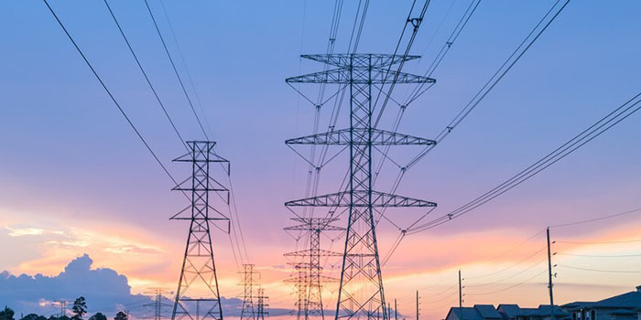
Potential of Grid expansion
AREAS OF COOPERATION
Poland is one of the largest manufacturers of cables in the whole of Europe.
Cables from the Polish TFK Group connect the offshore wind farm Nordsee One with the mainland.
Polish suppliers of switch cabinets and grid technology such as ZPUE are also involved.
Notes:
Germany faces a similar challenge to Poland when it comes to decarbonising its electricity supply. A large part of Germany's industry is located in the south. However, there is a lot of potential for wind and solar energy in the north of the country. The electricity must be transported from north to south using new power lines. This also opens up new opportunities for Polish companies.
Poland is one of the largest manufacturers of cables in the whole of Europe. Cables from the Polish TFK Group connect the offshore wind farm Nordsee One with the mainland. TFK's solutions are also used on land. The company has laid over 12 kilometres of high-voltage cables on behalf of energy supplier SachsenEnergie. Polish suppliers of switch cabinets and grid technology such as ZPUE are also involved.

Slide 21




Subsidy programs
CETEF’2024 Krakow
178 billion euros will be made available by 2026 to promote the energy transition and climate protection
Real estate: federal funding for efficient buildings (BEG) - energy-efficient refurbishments through promotional loans (KfW funding) or grants
For companies: Energy efficiency of processes, systems and machines
Indirect promotion: guaranteed feed-in tariffs, export guarantees
Notes:
With the Federal Subsidy for Efficient Buildings (BEG): an energy subsidy program for private individuals, companies, municipalities and public institutions that want to reduce the energy requirements and CO₂ emissions of all types of properties.
The state supports comprehensive energy-efficient renovations through promotional loans (KfW funding) or grants for individual measures such as the installation of a new heating system (BAFA funding).
Programs for improving the energy efficiency of processes, systems and machines.
Transport: Subsidies for the development of charging infrastructure and public transport (promotion of local and long-distance public transport; Charging Infrastructure Master Plan II).
Renewable energies - indirect subsidies
Cushioning investment risks - state support for photovoltaics and other renewable energy systems via a guaranteed feed-in tariff.
Export credit guarantees (“Hermes guarantees”), with which the federal government secures exports. For companies that manufacture renewable energy and other energy transition technologies in Germany.
The German government has significantly accelerated the expansion of wind and solar power plants. The foundations for this were laid with various laws and support packages (the Wind on Land Act and the Wind Energy at Sea Act, the first solar package and several amendments to the Energy Industry Act; Pact for the Acceleration of Planning and Approval - the pace for the expansion of renewable energies is thus being increased).
Nowy fragment:
Heat transition
- In order to meet the climate targets set out in the Paris Climate Agreement, the way we heat our homes must also be adapted. Around three quarters of heating systems are still fuelled by fossil gas or oil. With the Renewable Heating Act - the Building Energy Act (GEG) - the German government is initiating the switch to climate-friendly heating systems.
- The GEG stipulates that all new heating systems must be powered by 65 per cent renewable energy by mid-2028 at the latest. The necessary replacement of heating systems will be subsidised by the state. Since the start of the funding (on 27 February 2024), KfW (Kreditanstalt für Wiederaufbau) has issued around 93,000 approvals for grants - worth around 1.3 billion euros.

Slide 22

Thank you for your attention!
Dr. Lars Gutheil
Executive Board Member
+48 22 53 10 525
dyrektor@ahk.pl

